Slide 1

Institute of Engineering and Technology
DAVV
VLSI arduino based PROJECT
PROJECT : SNAKE GAME

Slide 2
Electronics and telecommunications
(TC-A) 3RD YEAR
Group member name:
1.Ankit Aswar(19T6006)
2.Khushi Kasbe(19T6033)
3.Shubh Saxena(19T6060)
Submitted To:
Vaibhav Neema Sir

Slide 3
introduction
Snake Game has been very popular since the beginning of the Mobile phones. Initially it was come in Black and white cell phones, and soon became very famous. Then with the advancement of the Cellphones, this game has also changed a lot, and now many graphical and colourful versions of this game are available.
Snake game has also become very popular DIY project for electronics Hobbyist and Students. So today we are going to demonstrate, Arduino Snake Game, with all its basic functionalities, while keeping it simple at the same time.

Slide 4
Component used :
Arduino UNO
8x8 LED Dot Matrix Display
Joystick
Connecting wires
Bread Board
Power Supply

Slide 5
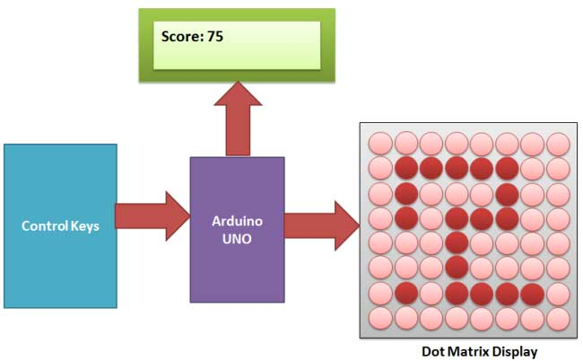

Slide 6
Block diagram description
The block diagram contains Arduino UNO, LCD, control keys, dot matrix display. Arduino controls the working of the other components. Control keys controls the direction of movement of snake. LCD is used to display the score and the commands like 'Press Start'. Arduino contains the code. The dot matrix is used to display the snake game (i.e. the movement of the snake) To make this project, we have used an 8x8 red colour dot matrix display for displaying the snake and its food dot, a LCD for displaying the points or score, 5 push buttons for giving directions and start the game and finally an Arduino UNO for controlling the whole

Slide 7
Circuit Explanation:
Circuit of this Snake Game Project is little complex. Here we have connected dot matrix display by using Shift Register 74HC595. Here two shift registers are used, one for driving the columns and second for driving the rows. Control pins of both the registers, Column shift register and row shift register (SH, ST), are directly connected to Arduino’s pin number 14 and 16 respectively. And DS pin of column shift register and row shift register are directly connected to pin number 15 and 17 of Arduino. Start button for start the game is connected at pin number 3, left direction button at pin 4, right direction button at pin 6, up direction button at pin 2 and down direction button at pin 5. A LCD is also connected in our hardware to show score. RS and EN pins are directly connected at pin 13 and 12. RW pin is directly ground. And data pins d4-d7 are connected at pin 11, 10, 9, 8 of Arduino. Rest of connection are shown in the circuit diagram.

Slide 8
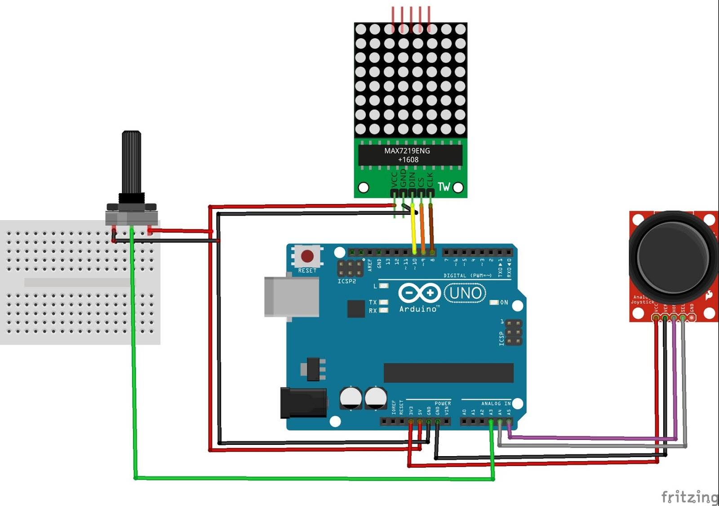
Circuit diagram:-

Slide 9
Circuit description
Circuit of this Snake Game Project is little complex. Here we have connected dot matrix display by using Shift Register 74HC595. Here two shift registers are used, one for driving the columns and second for driving the rows. Control pins of both the registers, Column shift register and row shift register (SH, ST), are directly connected to Arduino's pin number 14 and 16 respectively. And DS pin of column shift register, and row shift register are directly connected to pin number 15 and 17 of Arduino. Start button for start the game is connected at pin number 3, left direction button at pin 4, right direction button at pin 6, up direction button at pin 2 and down direction button at pin 5. A LCD is also connected in our hardware toshow score. RS and EN pins are directly connected at pin 13 and 12. RW pin is directly ground. And data pins d4-d7 are connected at pin 11, 10, 9, 8 of Arduino. Rest of connection are shown in the circuit diagram.

Slide 10
List of components
1. Arduino UNO- Arduino is an open source computer hardware andsoftware company, project, and user community that designs andmanufactures single-board microcontrollers and microcontroller kits building digital devices and interactive objects that can sense and control objects in the physical and digital world.
2. 8x8 LED Dot Matrix Display- The bare LED matrix has 16 pin outswith 8 common positive and another 8 common negative.
3. Shift Register 74HC595- a shift register is a cascade of flip flops, sharingthe same clock, in which the output of each flip-flop is connected to the'data' input of the next flip-flop in the chain, resulting in a circuit that shiftsby one position the 'bit array' stored in it, 'shifting in the data present at its input and 'shifting out the last bit in the array, at each transition of the clock
4. 16x2 LCD- A liquid-crystal display (LCD) is a flat-panel display or other electronically modulated optical device that uses the light-modulatinginput.properties of liquid crystals.
5. POT IK- This 1K potentiometer is a two-in-one, good in a breadboard orwith a panel.1
6. Push Buttons- a button that is pushed to operate an electrical device.
7. Connecting wires- these are wires which are used for interconnection between components.8. Bread Board- a board for making an experimental model of circuit.
8. bread board- a board for making an experiment model of an electric circuit.

Slide 11
Working Explanation:
This is little complicated game to build. But in this tutorial, we have made it simple for you. To make this project, we have used an 8x8 red colour Dot matrix display for displaying the snake and its food dot, a LCD for displaying the points or score, 5 push buttons for giving directions and start the game and finally an Arduino UNO for controlling the whole the process. Pin diagram of 8x8 LED Dot Matrix Display with its original image has been given below:

Slide 12
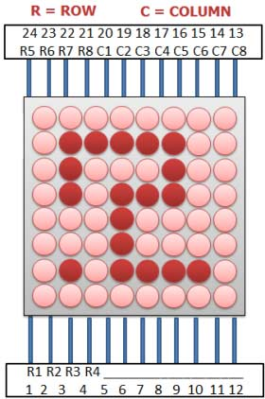

Slide 13
When we power up the circuit, first we show a welcome message and then a “Press Start To Play” hint on the LCD. After this, LCD shows the score as zero and dot matrix display shows two dots as snake and a single dot as food.
Now user need to press the middle button to start the game and snake start moving in upward direction by default. Then user needs to give direction to snake by pressing the ‘Direction keys’ around the middle button. Here we have used five keys (push buttons) namely Left key, Right key, Up key, Down key and Start key. Whenever the snake reaches to the food dot or eats the food, score increases by 5 points each time and the Snake length is increased by one dot (LED) each time, also snake speed become faster than before. And whenever snake would strike at any wall or reach at the end of LED matrix, then it would end the game (“Game Over”). Then user needs to start game again by pressing start key.

Slide 14
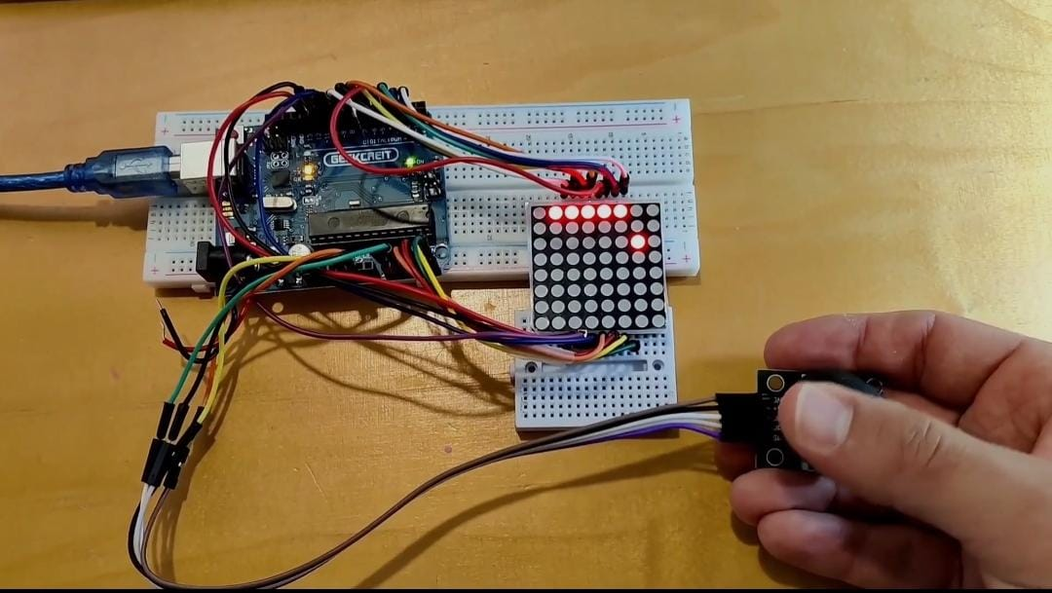
Project image

Slide 15
Programming Explanation:
CODE:-
#include<LiquidCrystal.h> LiquidCrystal lcd(13,12,11,10,9,8);
#define ds_col 15 #define sh_col 16 #define st_col 14 #define ds_row 17
#define start 3 #define up 2 #define down 5 #define left 4 #define right 6
char Col[21],Row[21],move_c,move_r;
To write this Arduino snake game code, first of all we include header files and define pins for LCD. And then define some pins for direction buttons and data pin for shift registers.

Slide 16
int row_data(int temp)
{
switch(temp)
{
case 1: return 1;break;
case 2: return 2; break;
case 3: return 4; break;
case 4: return 8; break;
case 5: return 16; break;
case 6: return 32; break;
case 7: return 64; break;
case 8: return 128; break;
default: return 0; break;
}
}
int colum_data(int temp)
{
switch(temp)
{
case 1: return 1;break;
case 2: return 2; break;
case 3: return 4; break;
case 4: return 8; break;
case 5: return 16; break;
case 6: return 32; break;
case 7: return 64; break;
case 8: return 128; break;
default: return 0; break;
}
}

Slide 17
void read_button()
{
if(!digitalRead(left))
{
move_r=0;
move_c!=-1 ? move_c=-1 : move_c=1;
while(!digitalRead(left));
}
if(!digitalRead(right))
{
move_r=0;
move_c!=1 ? move_c=1 : move_c=-1;
while(!digitalRead(right));
}
if(!digitalRead(up))
{
move_c=0;
move_r!=-1 ? move_r=-1 : move_r=1;
while(!digitalRead(up));
}
void read_button()
{
if(!digitalRead(left))
{
move_r=0;
move_c!=-1 ? move_c=-1 : move_c=1;
while(!digitalRead(left));
}
if(!digitalRead(right))
{

Slide 18
move_c=0;
move_r!=-1 ? move_r=-1 : move_r=1;
while(!digitalRead(up));
}
}
void show_snake(int temp)
{
for(int n=0;n<temp;n++)
{
int r,c;
for(int k=0;k<21;k++)
{
int temp1=Col[k];
+)
c=colum_data(temp1);
int temp2=Row[k];
r=0xff-row_data(temp2);
for(int i=0;i<8;i++)
{
int ds=(c & 0x01);
digitalWrite(ds_col, ds);
ds=(r & 0x01);
digitalWrite(ds_row, ds);
digitalWrite(sh_col, HIGH);
c>>=1;
r>>=1;
digitalWrite(sh_col, LOW);
}

Slide 19
digitalWrite(st_col, HIGH);
digitalWrite(st_col, LOW);
read_button();
delayMicroseconds(500);
}
}
}
void setup()
{
lcd.begin(16,2);
pinMode(ds_col, OUTPUT);
pinMode(sh_col, OUTPUT);
pinMode(st_col, OUTPUT);
pinMode(ds_row, OUTPUT);
pinMode(start, INPUT);
pinMode(up, INPUT);
pinMode(down, INPUT);
pinMode(left, INPUT);
pinMode(right, INPUT);
digitalWrite(up, HIGH);
digitalWrite(down, HIGH);
digitalWrite(left, HIGH);
digitalWrite(right, HIGH);
digitalWrite(start, HIGH);
lcd.setCursor(0,0);
lcd.print(" Snake game ");
lcd.setCursor(0,1);

Slide 20
lcd.print(" To Play ");
delay(2000);
}
void loop()
{
int j,k,Speed=40,score=0;
j=k=move_c=0;
move_r=1;
lcd.clear();
lcd.setCursor(0,0);
lcd.print("Score: ");
lcd.print(score);
while(1)
{
for(int i=3;i<21;i++)
{
Row[i]=100;
Col[i]=100;
}
Row[0]=rand()%8+1;
Col[0]=rand()%8+1;
Row[1]=1;
Col[1]=1;
Row[2]=2;
Col[2]=1;

Slide 21
j=2,k=1;
while(k==1)
{
move_c=0;
move_r=1;
show_snake(1);
lcd.setCursor(7,0);
lcd.print(score);
if(!digitalRead(start))
{
k=2;
Speed=40;
score=0;
}
}
while(k==2)
{
show_snake(Speed);
if(Row[1]>8 || Col[1]>8 || Row[1]<0 || Col[1]<0)
{
Row[1]=1;
Col[1]=1;
k=1;
lcd.setCursor(0,1);
lcd.print("Game Over");
delay(5000);
score=0;

Slide 22
lcd.clear();
lcd.setCursor(0,0);
lcd.print("Score: ");
lcd.print(score);
}
if(Row[0]==Row[1]+move_r && Col[0]==Col[1]+move_c)
{
j++;
Speed-=2;
score=score+5;
lcd.setCursor(7,0);
lcd.print(score);
Row[0]=rand()%8+1;
Col[0]=rand()%8+1;
}
for(int i=j;i>1;i--)
{
Col[i]=Col[i-1];
Row[i]=Row[i-1];
}
Col[1]=Col[2]+move_c;
Row[1]=Row[2]+move_r;
}
}
}

Slide 23
THE END
THANK YOU!!!!!!!

